Slide 1
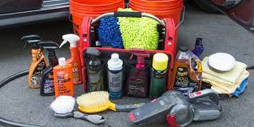
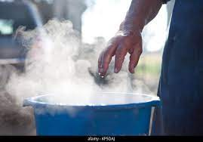
Basic maintenance of a vehicle
(Practical demonstration
Exterior
Step 1 Organize cleaning materials.
Step 2 Fill up one of the buckets with warm water.

Slide 2
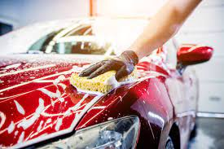
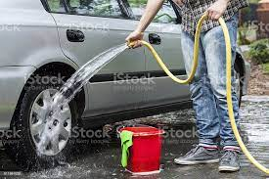
Basic maintenance of a vehicle
Practical demonstration (continues)
Step 3 Soak sponge in the soapy bucket and apply solutions to the car.
Step 4 Use hose or bucket of clean water to rinse off bubbles.

Slide 3
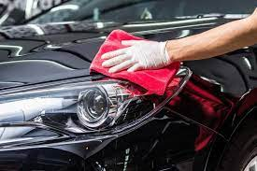
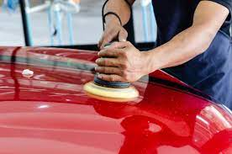
Basic maintenance of a vehicle
Practical demonstration (continues)
Step 5 Buff the car dry.
Step 6 Apply wax or polish for extra shine and protection.

Slide 4
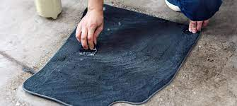
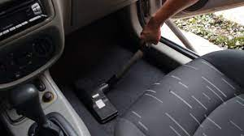
Basic maintenance of a vehicle
(Practical demonstration
Interior
Step 1 Take out and clean floor mats.
Step 2 Vacuum the interior of the car.

Slide 5
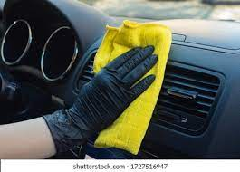
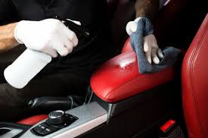
Basic maintenance of a vehicle
(Practical demonstration
Interior
Step 3 Clean dust on the dashboard.
Step 4 Carefully clean the console.

Slide 6
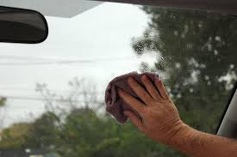
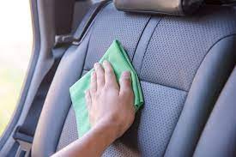
Basic maintenance of a vehicle
(Practical demonstration
Interior
Step 5 Wipe interior windows.
Step 6 Take care of seats.

Slide 7
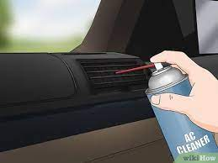
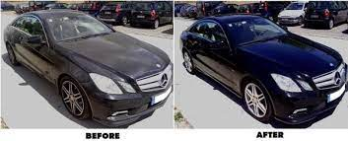
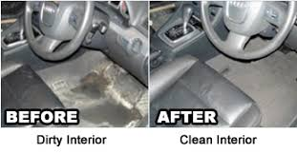
Basic maintenance of a vehicle
(Practical demonstration
Interior
Step 7 Deodorize.
Final maintenance.

